Slide 1

Recycling of Waste Heat through the Application of Nanofluidic Channels
Ievgen Nedrygailov

Slide 2
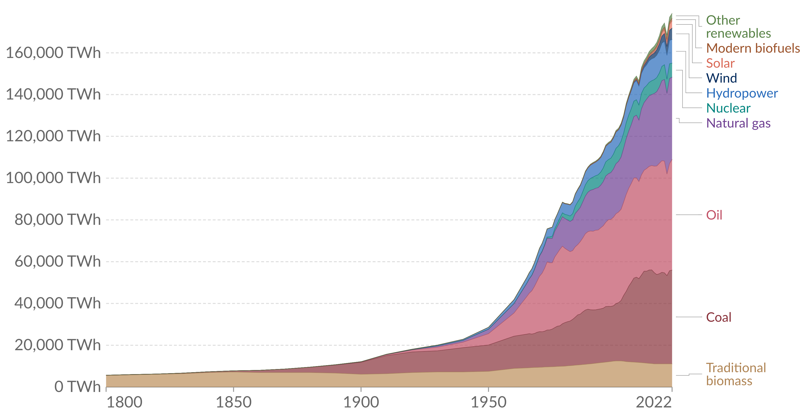
Before starting the Pionneer program
We had a clear understanding of the problem at hand
34 %
66 %
OurWorldInData.org/energy
Depleting our resources
Making an impact on the environment

Slide 3
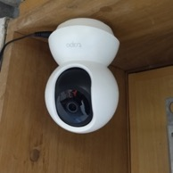
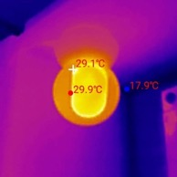
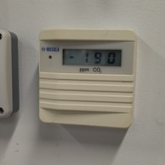
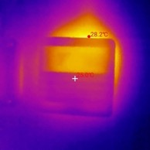
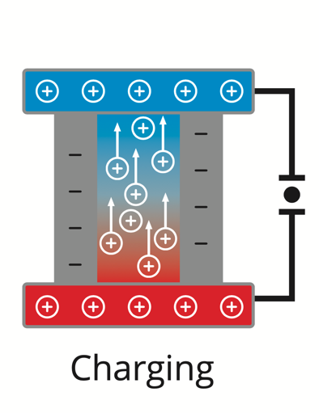
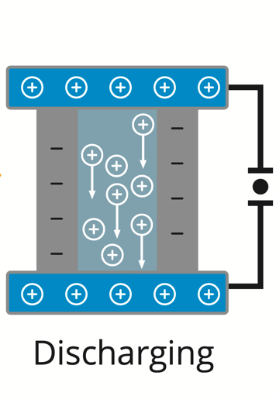
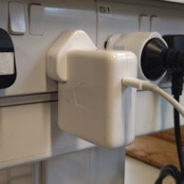
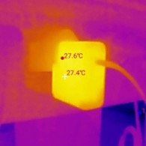
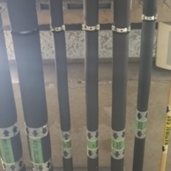
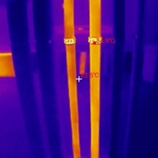


Before starting the Pionneer program
We had hope that our research could help find solutions to this problem
1. Harvest
2. Store
3. Use
$$∆T > 0$$
$$∆T= 0$$

Slide 4

Before starting the Pionneer program
We had no business experience and no idea how to create a product and bring it to market

Slide 5
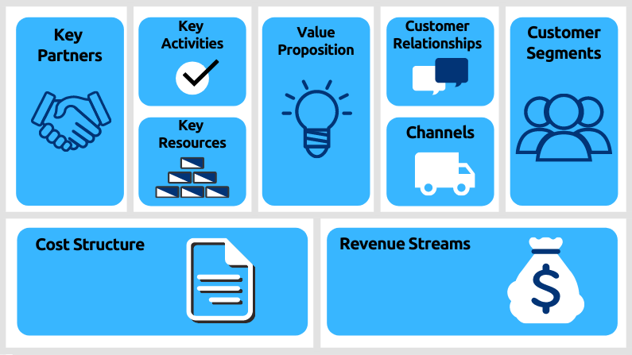
After starting the Pionneer program
We learned about the business model canvas
✅
✅
✅
✅
✅

Slide 6
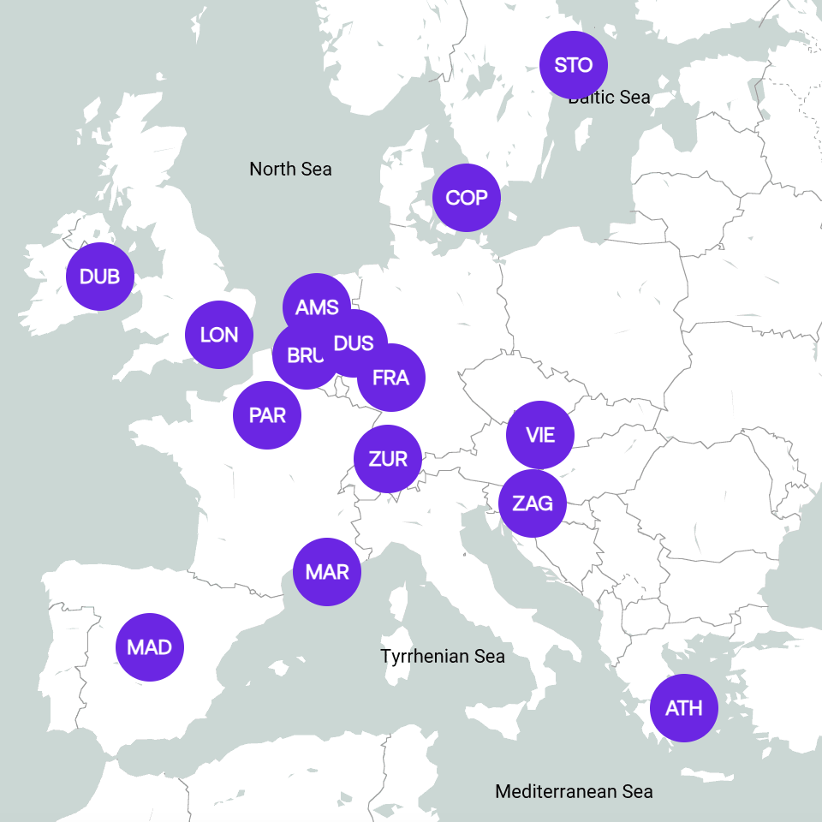
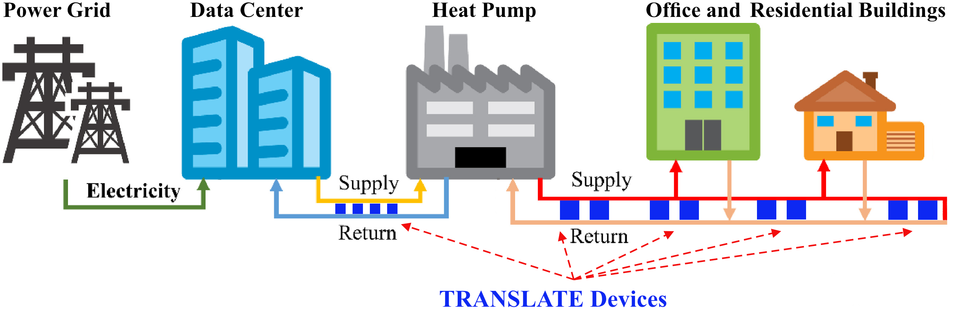
Data center heat recovery
The European data center market has 1,050 data centers operated by 304 providers
Data center heat recovery market could be worth $2.5 billion by 2025¹.
Data centers are capable of generating more than 100 MW of heat², which is enough to power up to 80,000 homes at average consumption
TRANSLATE devices in district heating networks
TRANSLATE devices could provide power to network electronics (including temperature and flow sensors, power meters, transmitters, etc.).
¹International Data Corporation (https://www.idc.com/)
²The World Economic Forum (https://www.weforum.org/agenda/2022/08/sustainable-data-centre-heating/)

Slide 7
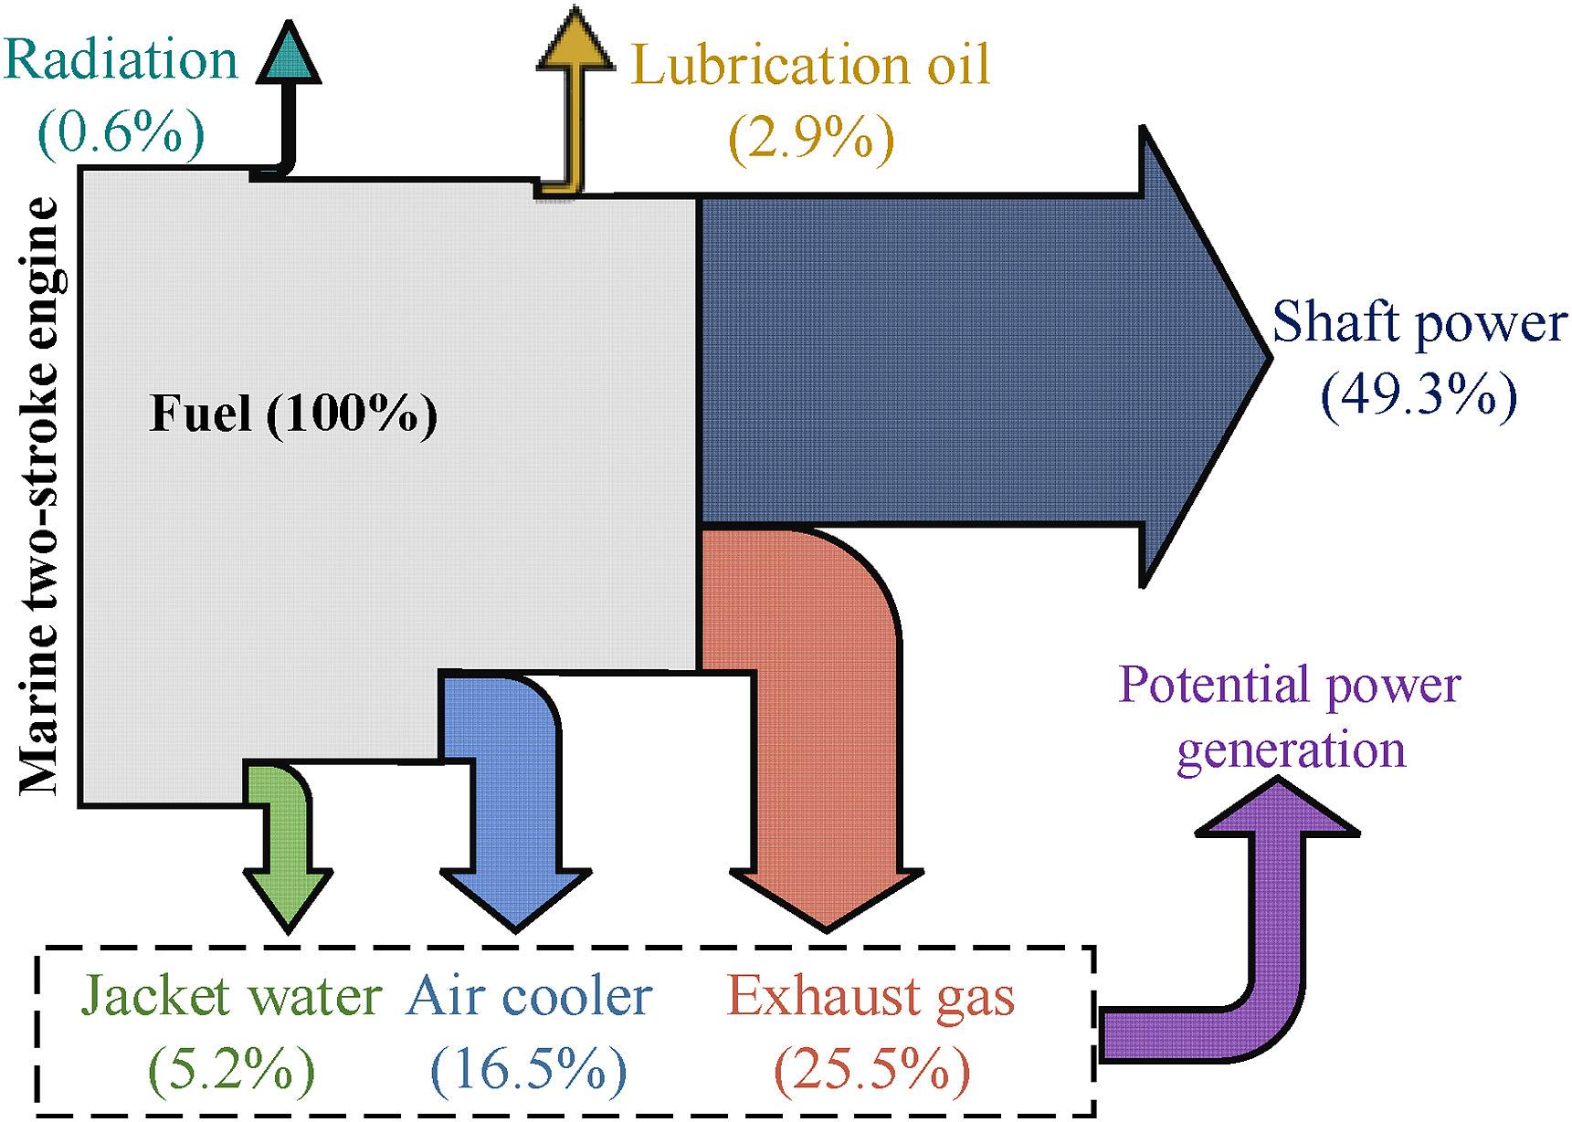
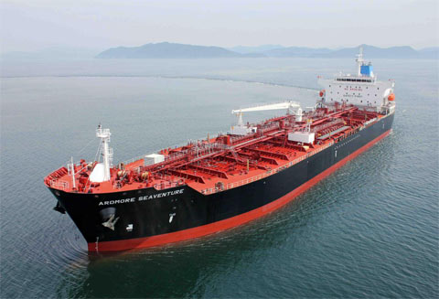
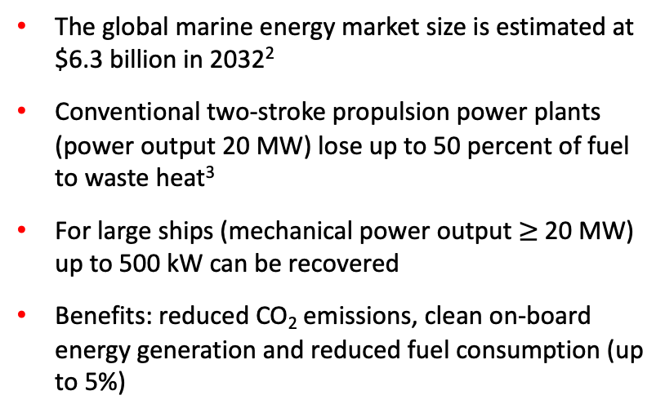
Heat recovery on ships
From 1 January 2023, ships must meet EEXI and CII requirements, which is the first step towards reducing the carbon intensity of all ships by 40% by 2030¹
The global marine energy market size is estimated at $6.3 billion in 2032²
Conventional two-stroke propulsion power plants (power output 20 MW) lose up to 50 percent of fuel to waste heat³
For large ships (mechanical power output $≥$20 MW) up to 500 kW can be recovered
Benefits: reduced CO₂ emissions, clean on-board energy generation and reduced fuel consumption (up to 5%)
TRANSLATE devices on ships
¹EEXI and CII - ship carbon intensity and rating system (https://www.imo.org/)
²Precedence Research (https://www.precedenceresearch.com/)
³Waste heat recovery technology (https://climeon.com/)

Slide 8
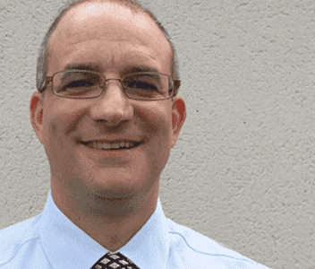
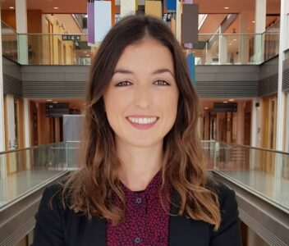
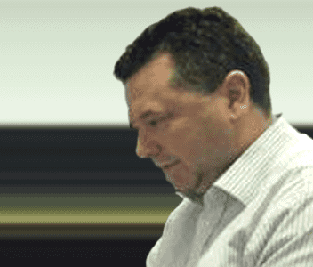
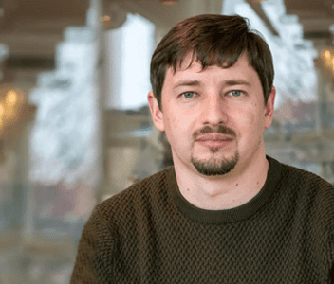
Our team
CEO and Founder
Justin Holmes
Business Development
Rebecca Buckley
Product Development
Scott Monaghan
Product Development
Ievgen Nedrygailov
Professor in Nanochemistry
Previously co-founded Glantreo
Cambridge University Graduate
Total experience over 10 years
Senior member of IEEE
PhD in Physics
Total experience 9 years
PhD in Chemistry

Slide 9
Our next steps
1 | Will we create the startup? | Yes!
2 | When do we want to create it? | We need another 2-3 years to complete the research. And some more time for their field testing.
3 | Who will create it? | We have a team of four people
4 | What are our next steps? | Studying, networking with people, attending business events and conducting research
5 | What are our immediate needs? | Knowledge, experience, mentoring, people and a complete business model

Slide 10
Thank you for your attention!
Contact us:
Email: rebecca.buckley@ucc.ie
inedrygailov@ucc.ie
Web: translate-energy.eu/

